Slide 1
Groups
Groups

Slide 2
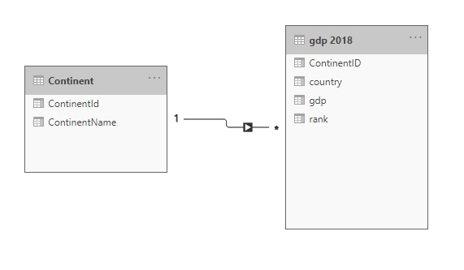
Groups
Note: This Lab uses the gdp.xslx file located in the resources\Drillthrough and Filter folder
Navigate to the location of the gdp.xslx file and load both tables continent and gdp 2018 at the query editor level
Check that the relationship between contains and gdp 2018 is established

Slide 3
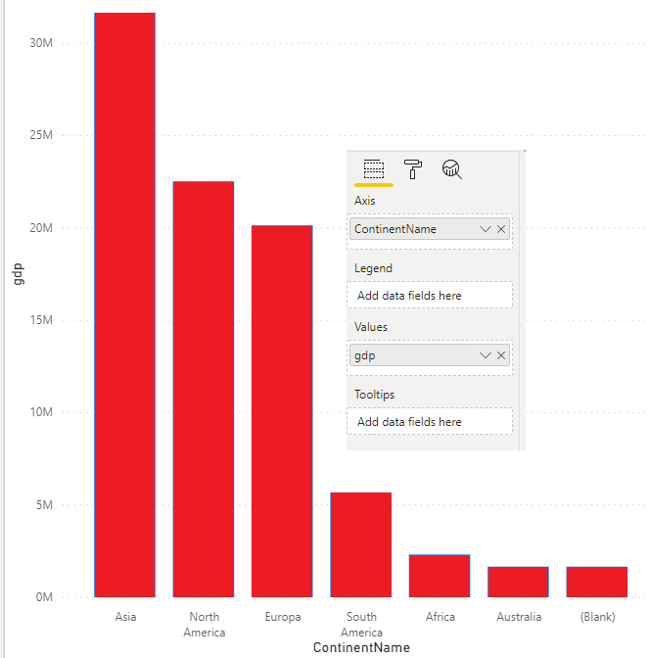
Groups
Add a Clustered Column visual to the scene and drag ContinentName and gdp to the Axis and Values properties respectively

Slide 4
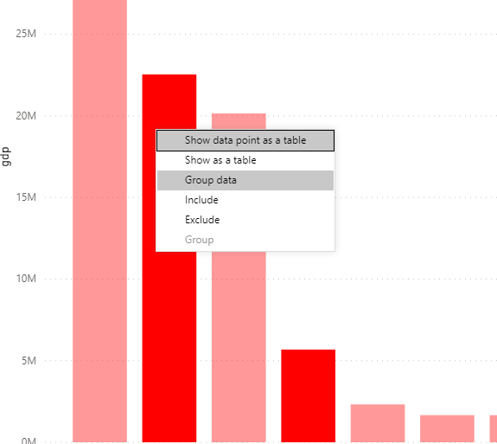
Groups
Select North and South America columns and then right click and select Group data

Slide 5
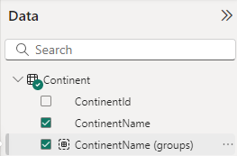
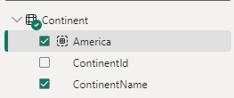
Groups
Notice the addition of a new field at the Continent table level rename it America

Slide 6
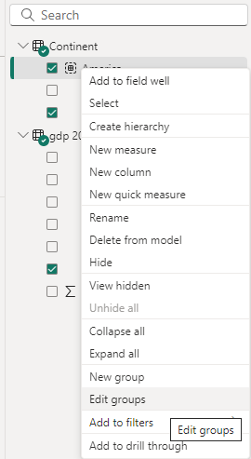
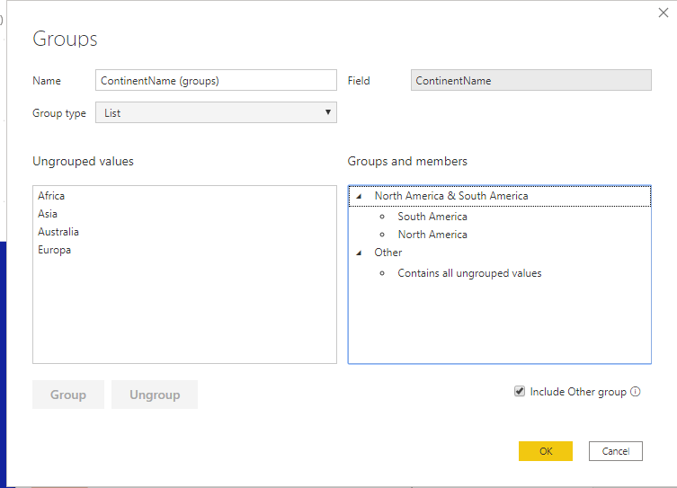
Groups
Right click on the newly added field and apply Edit groups

Slide 7
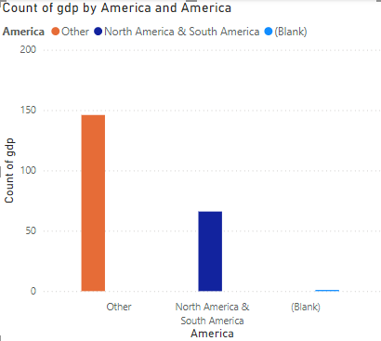
Groups
Replace the ContainsName field with the new ContainsName(groups) field which is called America now at the histogram level and notice the change in the data presentation

Slide 8
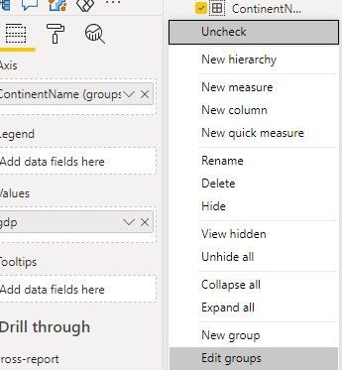
Groups
Edit the groups ContainsName(groups) by right clicking on it and clicking Edit groups

Slide 9
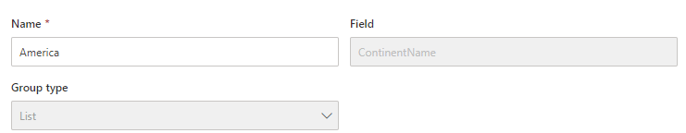
Groups
Notice that Group type shows only one option namely List only despite it being a drop down list and this is because the grouping subject field is non-numeric, notice also that the option is disabled
Select Africa in the left panel and click Group button, keep the name Africa in the new group
Now create a group that corresponds to each contain to represent the rest of the contains at the same histogram level

Slide 10
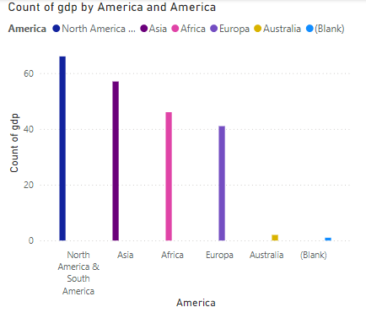
Groups
Now notice that the histogram changes structure, it now shows all continents.

Slide 11
Groups
Try to delete all groups and notice that this is not possible, you will need to have at least one group in the groups pane

Slide 12
Thank you
Thank you

